Slide 1
Cancer Cell Detection Using SVM
INSAID – Shweta Kallurkar

Slide 2
The Problem Statement
Cancer is the uncontrolled growth of abnormal cells, which do not carry out the functions of normal cells. It starts when cells in the begin to grow out of control. These cells usually form a tumor.
Early diagnosis significantly increases the chances of survivor. The key challenges against it's detection is how to classify tumors into malignant(Cancer) or benign(not cancer).
Machine Learning technique can dramatically improve the level of diagnosis in cancer.

Slide 3
Data Description
The dataset consists of several hundred human cell sample records, each of which contains the values of a set of cell characteristics. The fields in each record are:
Field name | Description
ID | Clump thickness
Clump | Clump thickness
UnifSize | Uniformity of cell size
UnifShape | Uniformity of cell shape
MargAdh | Marginal adhesion
SingEpiSize | Single epithelial cell size
BareNuc | Bare nuclei
BlandChrom | Bland chromatin
NormNucl | Normal nucleoli
Mit | Mitoses
Class | Benign or malignant

Slide 4
Data
ID | Clump | UnifSize | UnifShape | MargAdh | SingEpiSize | BareNuc | BlandChrom | NormNucl | Mit | Class
0 | 1000025 | 5 | 1 | 1 | 1 | 2 | 1 | 3 | 1 | 1 | 2
1 | 1002945 | 5 | 4 | 4 | 5 | 7 | 10 | 3 | 2 | 1 | 2
2 | 1015425 | 3 | 1 | 1 | 1 | 2 | 2 | 3 | 1 | 1 | 2
3 | 1016277 | 6 | 8 | 8 | 1 | 3 | 4 | 3 | 7 | 1 | 2
4 | 1017023 | 4 | 1 | 1 | 3 | 2 | 1 | 3 | 1 | 1 | 2

Slide 5
DATA
The ID field contains the patient identifiers. The characteristics of the cell samples from each patient are contained in fields Clump to Mit. The values are graded from 1 to 10, with 1 being the closest to benign.
The Class field contains the diagnosis, as confirmed by separate medical procedures, as to whether the samples are benign (value = 2) or malignant (value = 4).

Slide 6
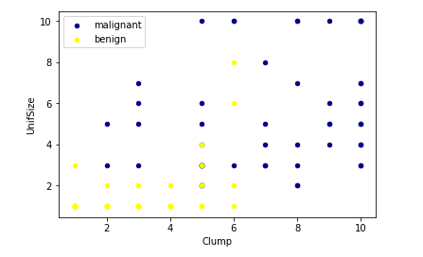
Exploratory Data Analysis

Slide 7
The SVM Model
A Support Vector Machine (SVM) is a binary linear classification whose decision boundary is explicitly constructed to minimize generalization error

Slide 8
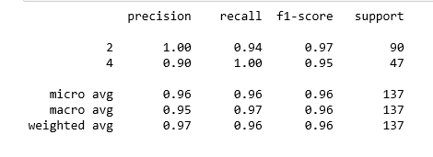
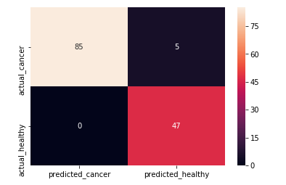
MODEL EVALUATION
Model Evaluation is done via Confusion Matrix

Slide 9
Conclusion
We can say that the SVM model can predict a new cell to be malignant(Cancer) or benign(not cancer) 96% times accurately. Hence this model can be useful in medical procedures

